Slide 1

Kanban 101

Slide 2
Kanban Principle
Proactivenes - Work is pulled, not pushed
Transparency - Workload is transparent, so everyone knows who is doing what
Definition - Everyone defines acceptance criteria for each task
Agreement - Everyone agrees that the acceptance criteria have been met

Slide 3
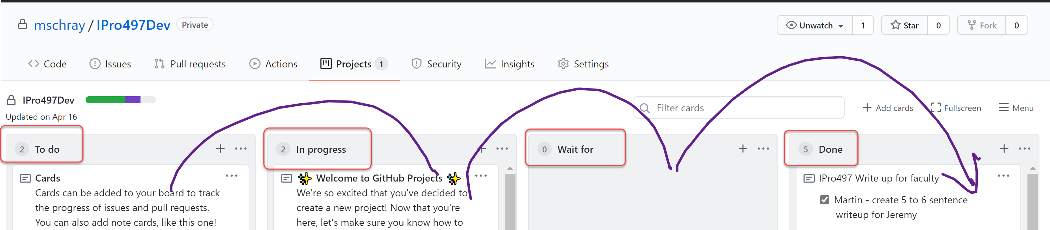
Columns in your Kanban form
Kanban Board

Slide 4
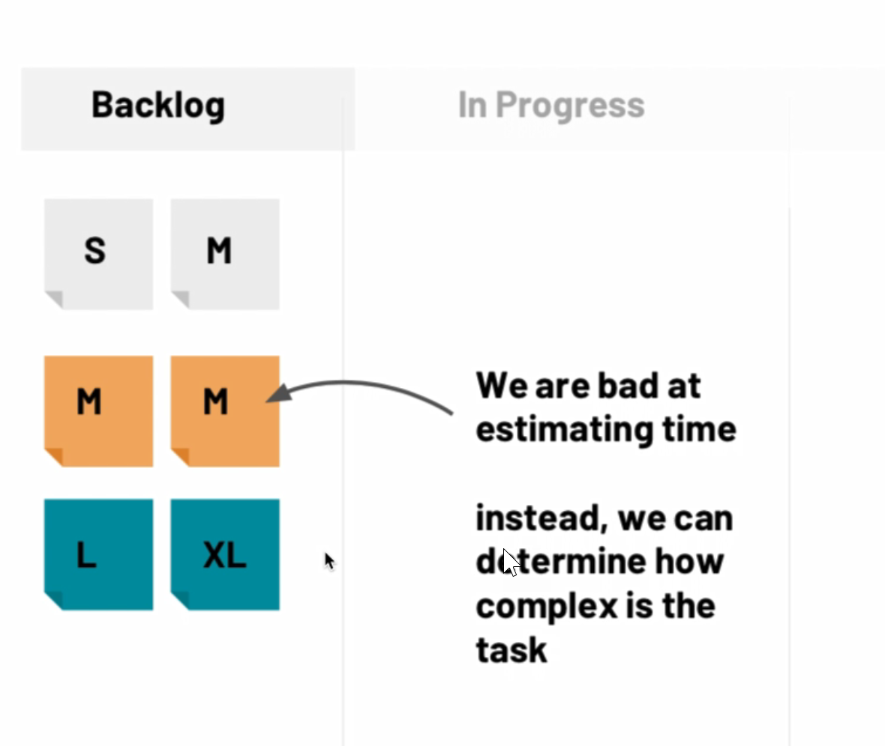
Sizing your work

Slide 5
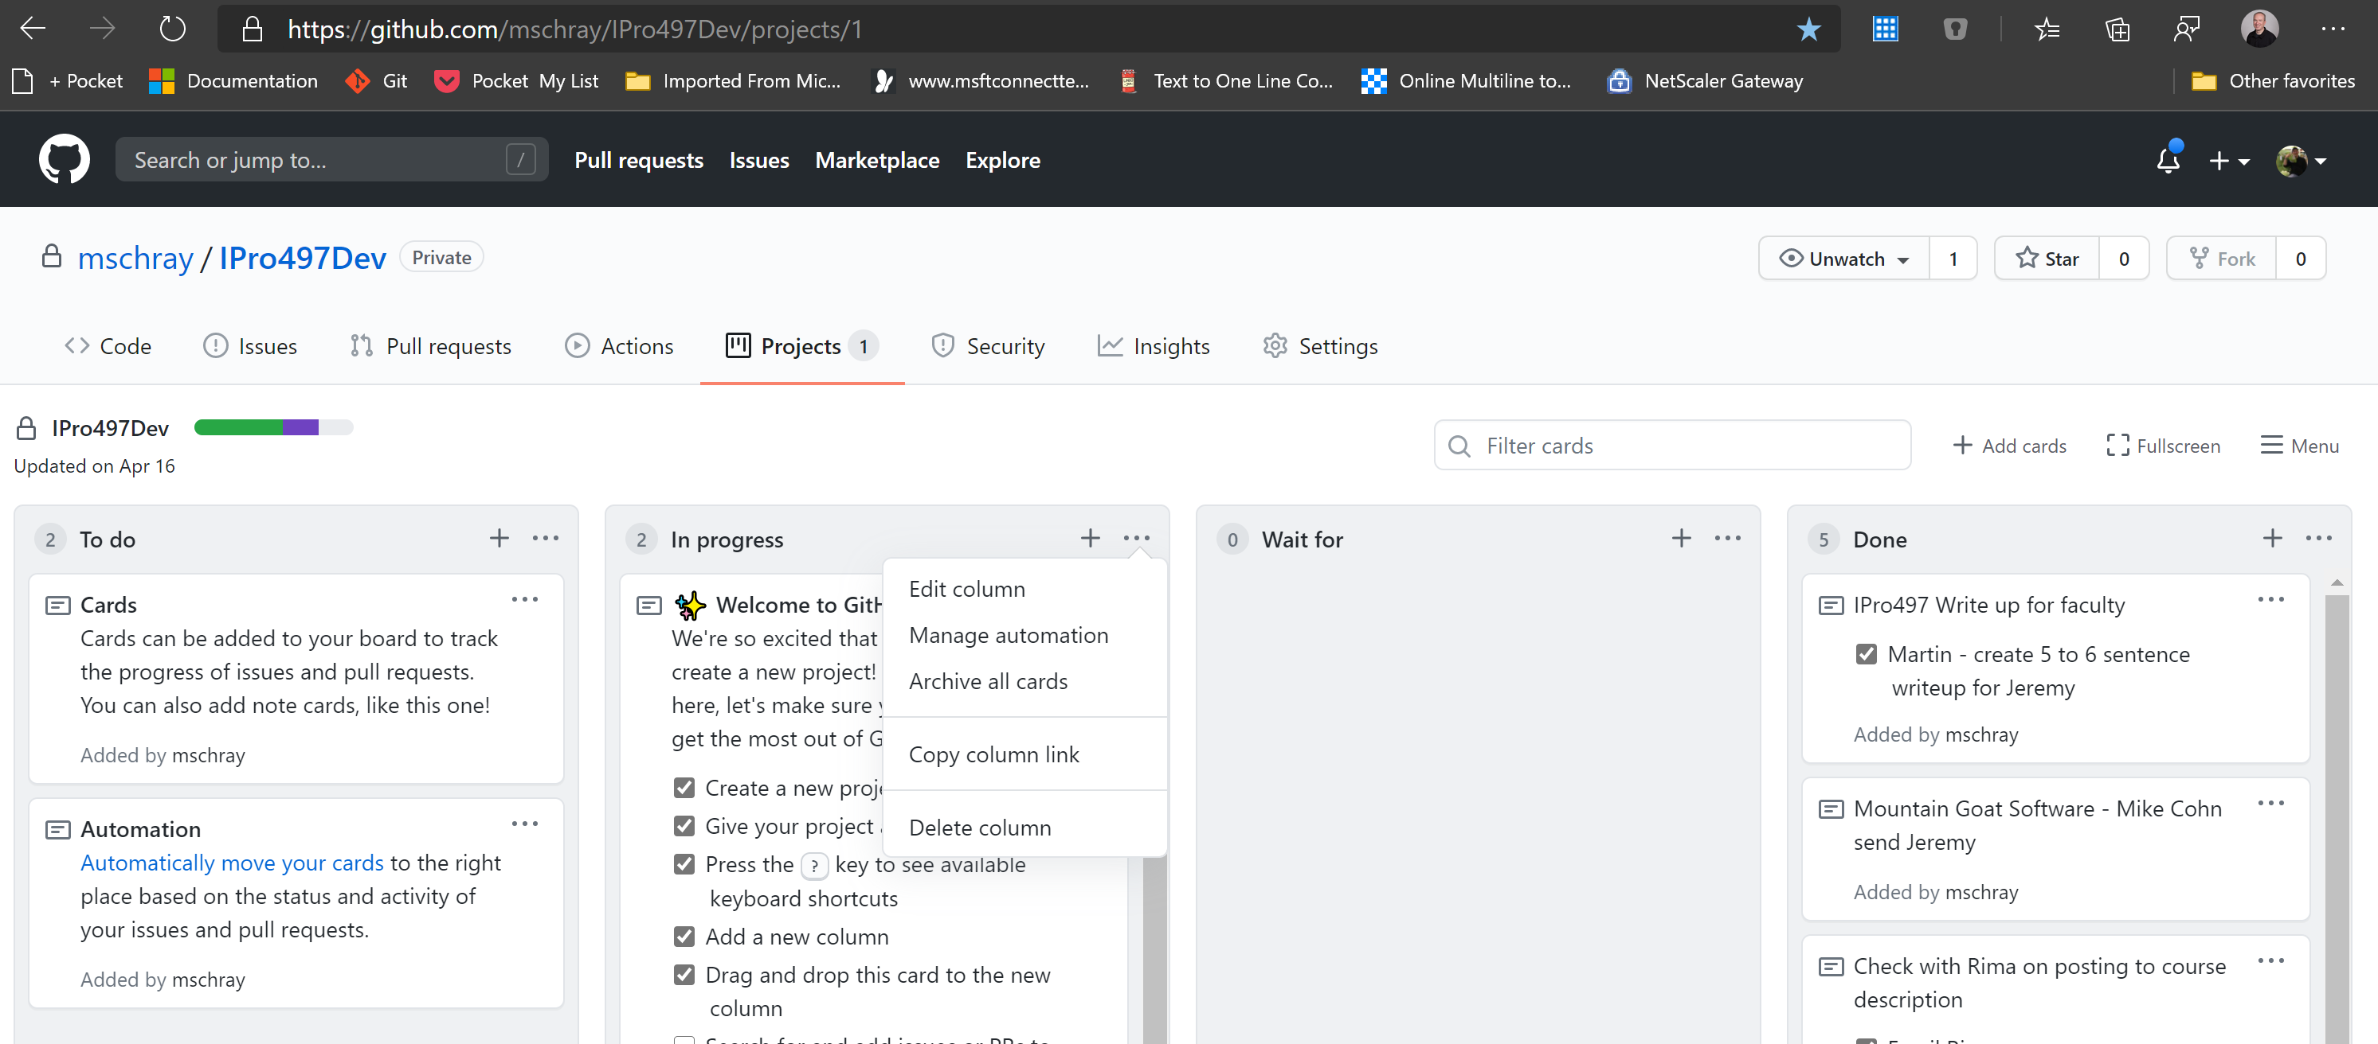
You can edit columns (hint: keep it simple)

Slide 6
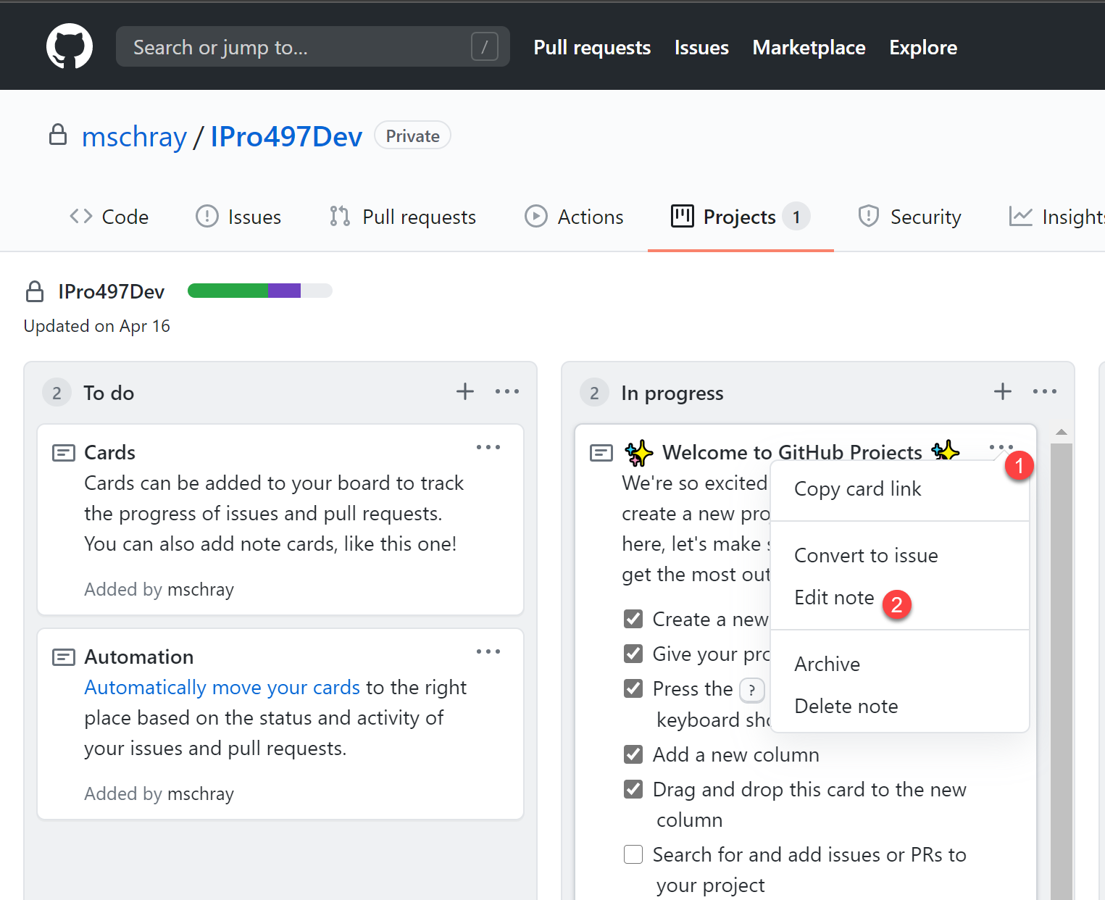
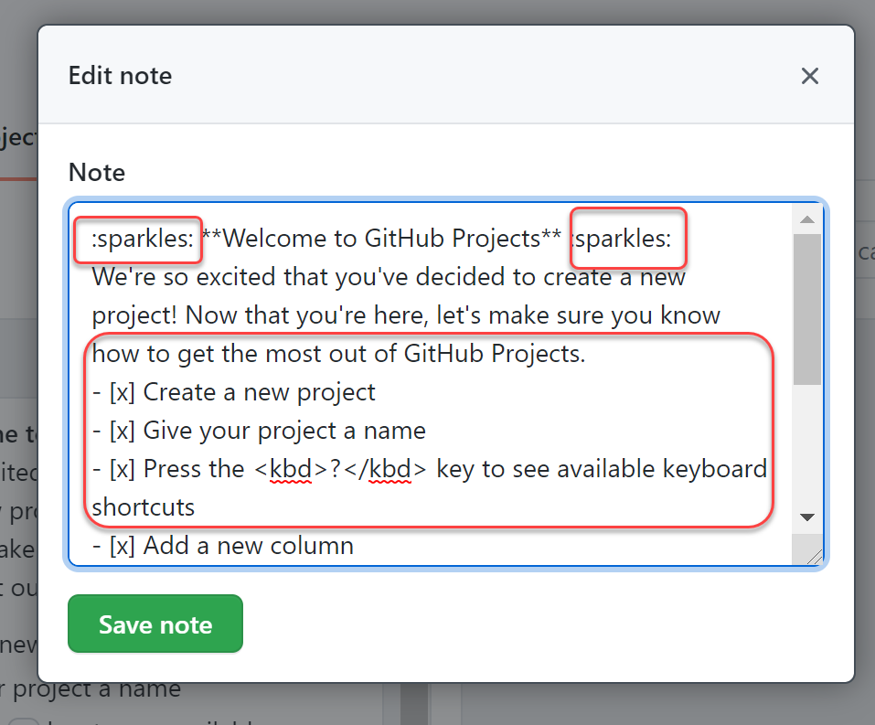
Notes can have rich markdown

